Slide 1

CSA-4302 INTERNETPROGRAMMING
CAPSTONE PROJECT
Scheme GO
A Platform for Government Scheme Eligibility and Application Assistance
Team Members
Avinaash A (192324260)
Sanjay G (192311437)
Sanjai S (192511018)
Guided by
Dr. T. Kosalairaman

Slide 2
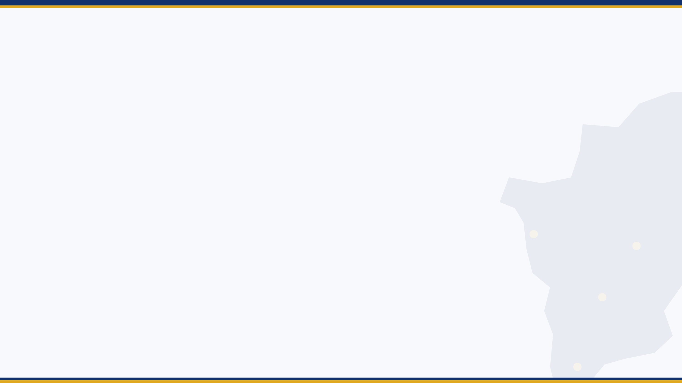



Problem Statement
Many eligible Tamil Nadu citizens never receive the welfare benefits meant for them.
Scattered information
Unclear eligibility
Confusing procedures
Hundreds of Tamil Nadu government schemes are spread across many departments and websites.
Citizens cannot easily tell which schemes they qualify for; criteria are complex and technical.
Required documents and application steps differ for every scheme and are hard to follow.
2

Slide 3
Objectives
1
To build a centralized web platform that brings all Tamil Nadu government schemes into one place.
2
To develop an eligibility engine that matches each citizen's profile with the schemes they qualify for.
3
To guide users step by step through required documents and application procedures in simple Tamil and English.
4
To provide application tracking and timely alerts that make the benefit process transparent.
3

Slide 4




Motivation / Need
Inclusion
Time & effort
Welfare reaches people only when they know about it. Better awareness means better inclusion.
Citizens lose days visiting offices and agents just to learn basic eligibility.
Trust & transparency
Digital Tamil Nadu
Clear steps and status tracking reduce dependence on middlemen and misinformation.
TN e-Sevai and rising smartphone use make a single guided portal practical today.
4

Slide 5
Literature Survey
Existing system | What it offers | What it is missing
myScheme (MeitY / NeGD) | National scheme search with eligibility filters. | No guided, end-to-end application; redirects to separate portals.
UMANG App | Single app for many government services. | Not eligibility-focused; discovery of schemes is limited.
Jan Samarth Portal | Eligibility check and apply for credit-linked schemes. | Covers only credit-linked schemes, not general welfare.
State portals (e.g. TN e-Sevai) | Department-wise certificates and services. | Siloed by department; no unified recommendations.
Gap: no single platform gives TN citizens eligibility, document guidance, application help and tracking.
5

Slide 6


Proposed Solution
Scheme GO is a one-stop web platform: the citizen enters a simple profile and the system does the rest.
Create profile
Check eligibility
Get guidance
Apply & track
Age, income, state, category, occupation
Rule engine matches schemes
Document checklist and steps
Status updates and alerts
Example TN schemes:
Magalir Urimai Thogai
Pudhumai Penn
Naan Mudhalvan
CMCHIS
6

Slide 7
System Architecture
Citizen
search, apply, track
Web Application
React.js
multilingual UI
REST API Server
Node.js + Express
authentication (JWT)
Eligibility Engine
rule-based matching
Application Guide
documents & steps
Admin
manage schemes & rules
Notifications & Tracker
status and alerts
Database: users, schemes, rules, applications
MongoDB
7

Slide 8



Tools and Technologies
Hardware
Software
Languages & Frameworks
Laptop / PC (i5, 8 GB RAM)
Smartphone for responsive testing
Internet connection
Cloud server for hosting
VS Code, Git and GitHub
Postman for API testing
Figma for UI design
MongoDB Compass
JavaScript, HTML, CSS, i18n
React.js (Tamil + English UI)
Node.js and Express (backend)
MongoDB (database)
8

Slide 9
Work Plan
0
1
2
3
Zeroth
Review 1
Review 2
Final Review
Topic, problem, literature survey, architecture
Requirement analysis, scheme data collection, UI wireframes, database design
Frontend and backend build, eligibility engine, login and document checklist
Notifications, multilingual support, testing, deployment, report
9

Slide 10
References
[1] National e-Governance Division, "myScheme: National Platform for Government Schemes," Government of India. https://www.myscheme.gov.in
[2] Ministry of Electronics and IT, "UMANG: Unified Mobile Application for New-age Governance." https://web.umang.gov.in
[3] Government of India, "Jan Samarth Portal: Credit Linked Government Schemes." https://www.jansamarth.in
[4] Government of Tamil Nadu , "Official Portal of Tamil Nadu Government." https://www.tn.gov.in
[5] Government of Tamil Nadu , "TN e-Sevai Citizen Services Portal." https://tnesevai.tn.gov.in
[6] Meta Open Source, "React Documentation." https://react.dev
[7] OpenJS Foundation, "Express - Node.js Web Application Framework." https://expressjs.com
10

